Slide 1
Computer Network_22CS008
Multiple Access Protocols
Lecture 43 (Theory)
Prepared By Dr. Chetna
Department of Computer Science and Engineering,
Chitkara University, Punjab

Slide 2
Index
,
Concept Multiple Access Resolution
Random Access Control
ALOHA(Pure and Slotted ALOHA)
Carrier Sense Multiple Access
Carrier Sense Multiple Access with Collision Detection
Carrier Sense Multiple Access with Collision Avoidance

Slide 3
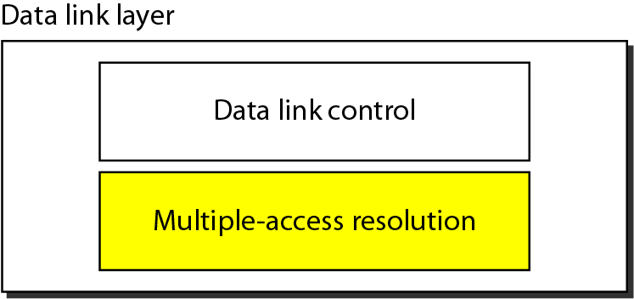
Data Link Layer Structure
The Data Link Layer is responsible for transmission of data between two nodes. Its main functions are-
Data Link Control
Multiple Access Control
Figure 1 Data Link Layer Strcuture

Slide 4
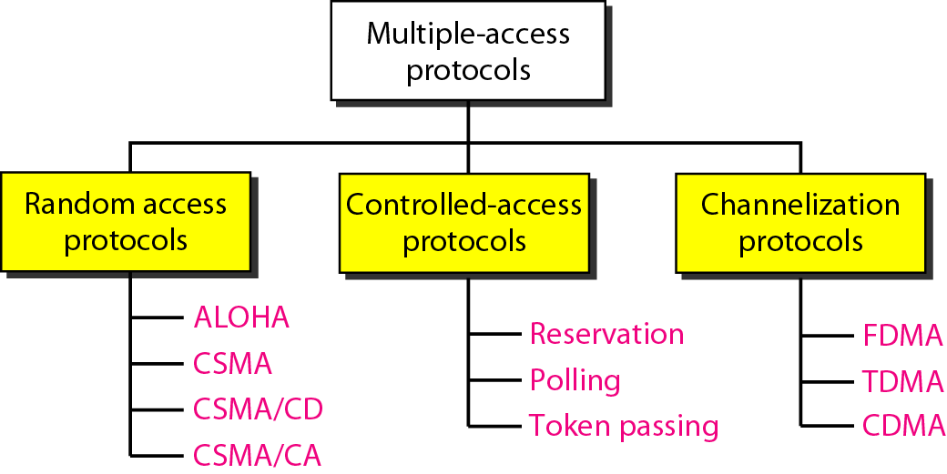
Types of Multiple access protocols
Following are the types of Multiple Access Protocols, which are separated into many different processes, are listed below
Figure 2 Types for Multiple Access Protocols

Slide 5
Random Access
In Random access or Contention methods, no station is superior to another station and none is assigned the control over another. No station permits, or does not permit, another station to send. At each instance, a station that has data to send uses a procedure defined by the protocol to make a decision on whether or not to send.
Types of Random Access
ALOHA
CSMA
CSMA/CD
CSMA/CA

Slide 6
Frames in a pure ALOHA network
Pure ALOHA uses a simple idea that is to let user transmit whenever they have to send.
Pure ALOHA having feature with the feedback property that enables the channel and finds the whether frame is destroyed.
Feedback in LANs immediate. But finds delay of 270 msecs in satellite transmission.
Pure ALOHA requires acknowledgement.
Pure ALOHA provides 18 percent of channel utilization.

Slide 7
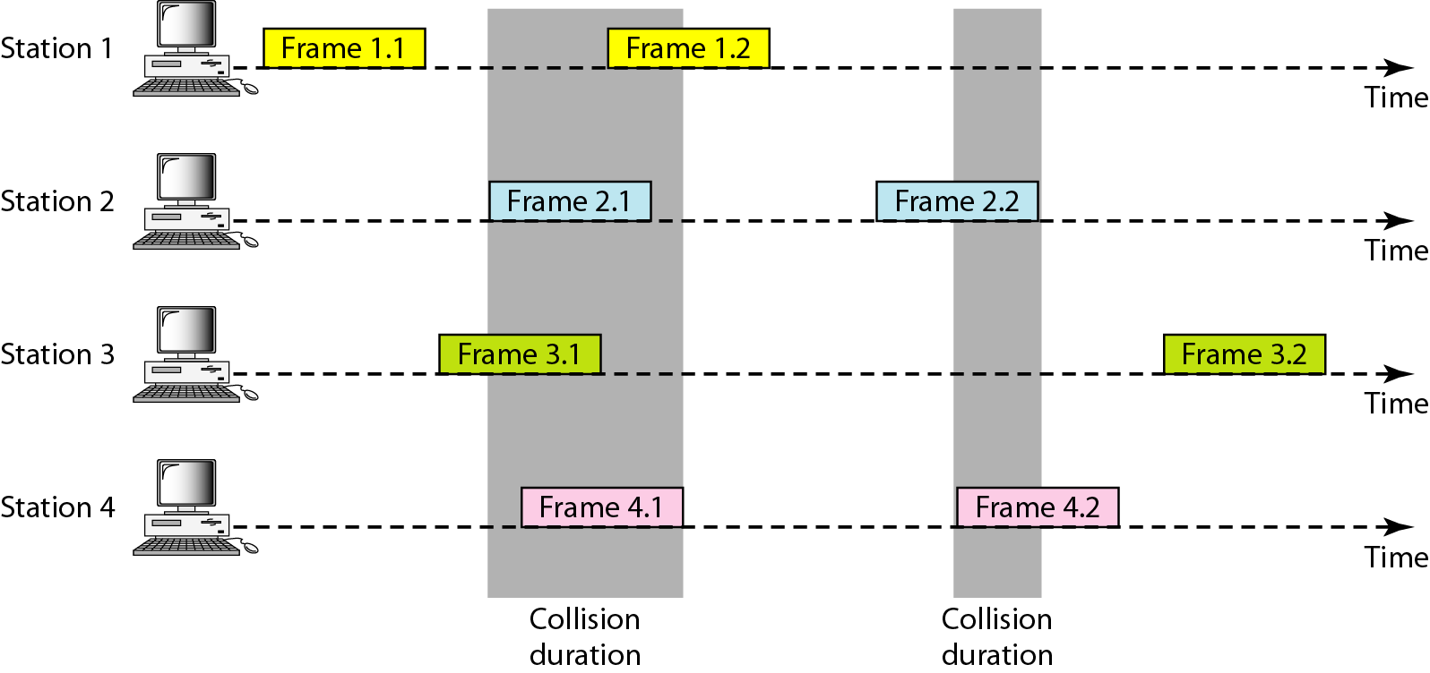
Frames in a pure ALOHA network
Figure 3 Procedure for pure ALOHA protocol

Slide 8
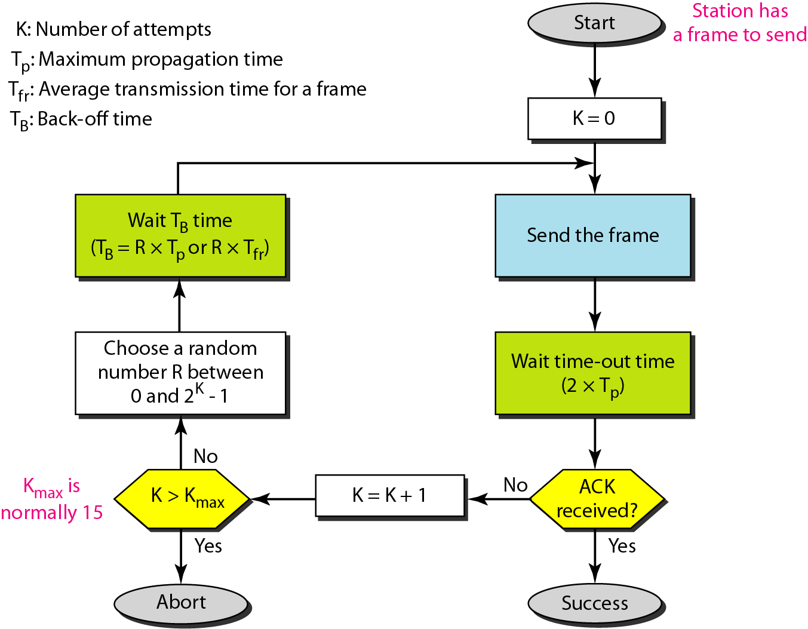
Procedure for pure ALOHA protocol
Figure 4 Procedure for pure ALOHA protocol

Slide 9
Example 1
The stations on a wireless ALOHA network are a maximum of 600 km apart. If we assume that signals propagate at 3 × 10⁸ m/s, we find
Tp = (600 × 10⁵ ) / (3 × 10⁸ ) = 2 ms.
Now we can find the value of T_{B} for different values of K .
a. For K = 1, the range is {0, 1}. The station needs to| generate a random number with a value of 0 or 1. This means that T_{B} is either 0 ms (0 × 2) or 2 ms (1 × 2), based on the outcome of the random variable.

Slide 10
Example 1 (continued)
b. For K = 2, the range is {0, 1, 2, 3}. This means that T_{B} can be 0, 2, 4, or 6 ms, based on the outcome of the random variable.
c. For K = 3, the range is {0, 1, 2, 3, 4, 5, 6, 7}. This means that T_{B} can be 0, 2, 4, . . . , 14 ms, based on the outcome of the random variable.
d. We need to mention that if K > 10, it is normally set to 10.

Slide 11
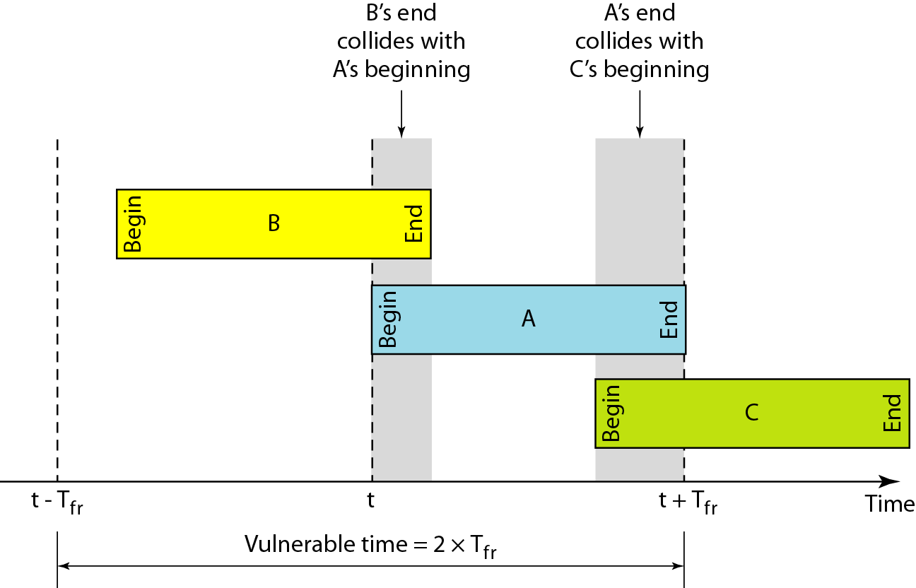
Vulnerable time - pure ALOHA protocol
Figure 5 Vulnerable time for pure ALOHA protocol

Slide 12
Example 2
A pure ALOHA network transmits 200-bit frames on a shared channel of 200 kbps. What is the requirement to make this frame collision-free?
Solution
Average frame transmission time T_{fr} is 200 bits/200 kbps or 1 ms. The vulnerable time is 2 × 1 ms = 2 ms. This means no station should send later than 1 ms before this station starts transmission and no station should start sending during the one 1-ms period that this station is sending.

Slide 13
Pure ALOHA Throughtput
The throughput for pure ALOHA is S = G × e ^{−2G} .
The maximum throughput
S_{max} = 0.184 when G= (1/2).

Slide 14
Example 3
A pure ALOHA network transmits 200-bit frames on a shared channel of 200 kbps. What is the throughput if the system (all stations together) produces
a. 1000 frames per second b. 500 frames per second
c. 250 frames per second.
Solution
The frame transmission time is 200/200 kbps or 1 ms.
a. If the system creates 1000 frames per second, this is 1 frame per millisecond. The load is 1. In this case S = G× e^{−2 G} or S = 0.135 (13.5 percent). This means that the throughput is 1000 × 0.135 = 135 frames. Only 135 frames out of 1000 will probably survive.

Slide 15
Example 3 (continued)
b. If the system creates 500 frames per second, this is (1/2) frame per millisecond. The load is (1/2). In this case S = G × e ^{−2G} or S = 0.184 (18.4 percent). This means that the throughput is 500 × 0.184 = 92 and that only 92 frames out of 500 will probably survive. Note that this is the maximum throughput case, percentagewise.
c. If the system creates 250 frames per second, this is (1/4) frame per millisecond. The load is (1/4). In this case S = G × e^{-2G} or S = 0.152 (15.2 percent). This means that the throughput is 250 × 0.152 = 38. Only 38 frames out of 250 will probably survive.

Slide 16
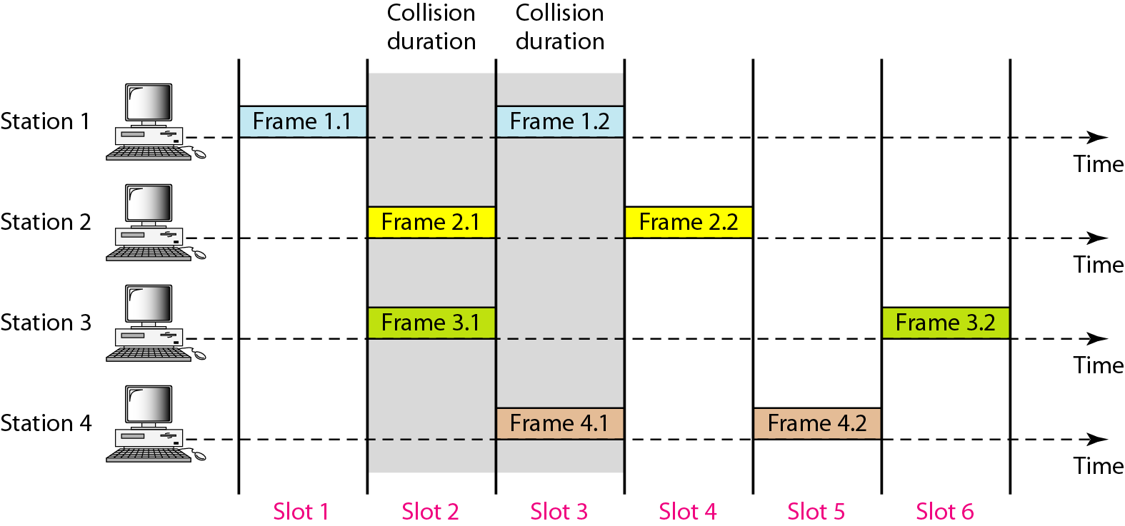
Frames in a slotted ALOHA network
Figure 6 Frames in a slotted ALOHA network

Slide 17
Slotted ALOHA Throughtput
The throughput for slotted ALOHA is S = G × e^{−G} .
The maximum throughput S_{max} = 0.368 when G = 1.

Slide 18
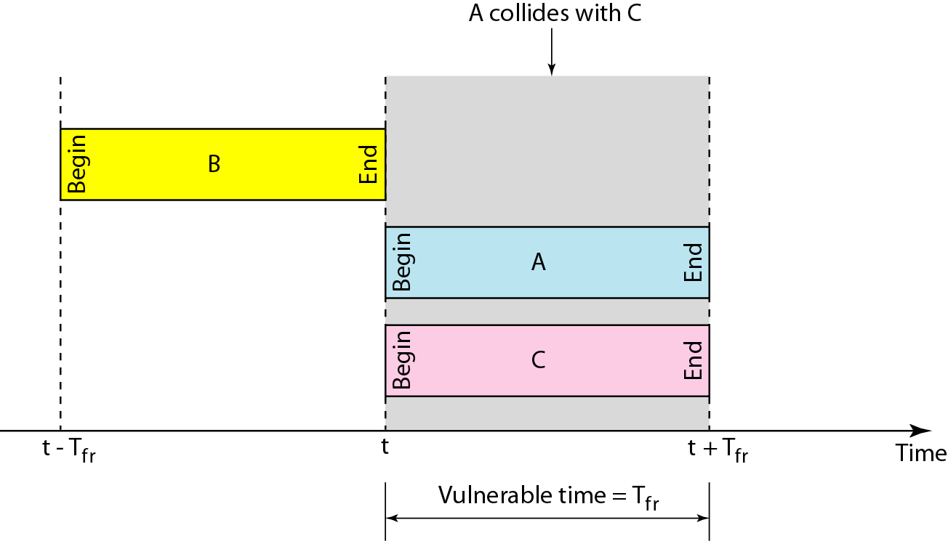
Vulnerable time for slotted ALOHA protocol
Figure 7 Vulnerable time for slotted ALOHA protocol

Slide 19
Example 4
A slotted ALOHA network transmits 200-bit frames on a shared channel of 200 kbps. What is the throughput if the system (all stations together) produces
a. 1000 frames per second b. 500 frames per second
c. 250 frames per second.
Solution
The frame transmission time is 200/200 kbps or 1 ms.
If the system creates 1000 frames per second, this is 1 frame per millisecond. The load is 1. In this case S = G× e^{−G} or S = 0.368 (36.8 percent).
This means that the throughput is 1000 × 0.0368 = 368 frames. Only 386 frames out of 1000 will probably survive.

Slide 20
Example 4 (continued)
b. If the system creates 500 frames per second, this is (1/2) frame per millisecond. The load is (1/2). In this case S = G × e^{−G} or S = 0.303 (30.3 percent). This means that the throughput is 500 × 0.0303 = 151. Only 151 frames out of 500 will probably survive.
c. If the system creates 250 frames per second, this is (1/4) frame per millisecond. The load is (1/4). In this case S = G × e^{−G} or S = 0.195 (19.5 percent). This means that the throughput is 250 × 0.195 = 49. Only 49 frames out of 250 will probably survive.

Slide 21
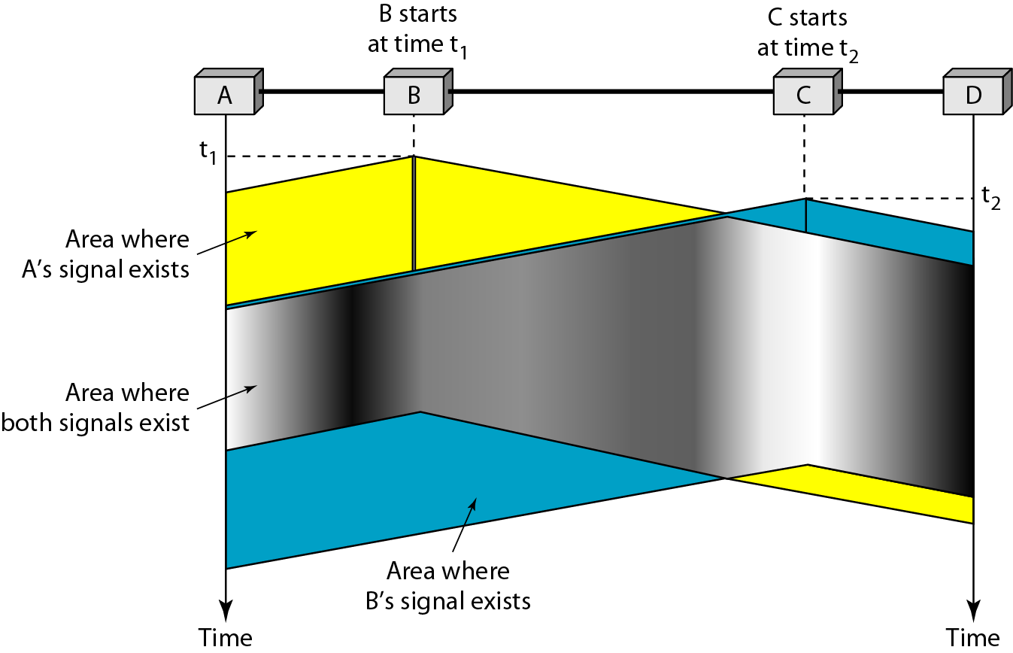
Space/time model of the collision in CSMA
Figure 8 Space/time model of the collision in CSMA

Slide 22
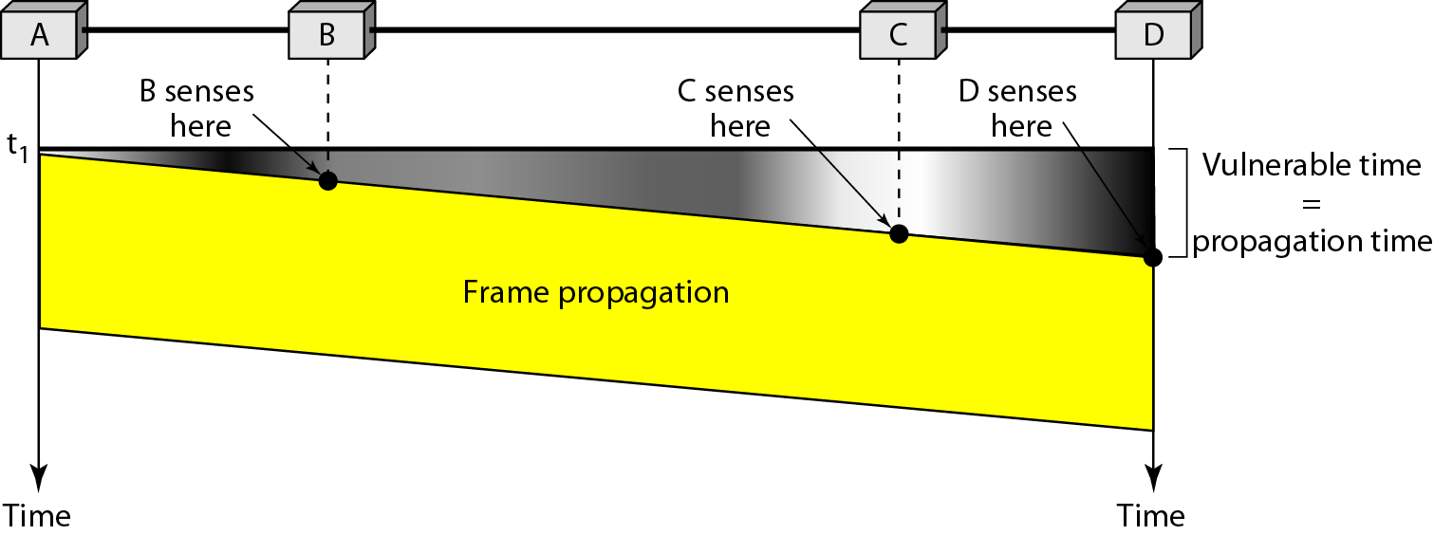
Vulnerable time in CSMA
Maximum propagation delay τ = the maximum time needed for a transmission from any source to reach all nodes in the CSMA system.
Vulnerable Time – Time in which there is possibility of Collision.
Figure 9 Vulnerable time in CSMA

Slide 23
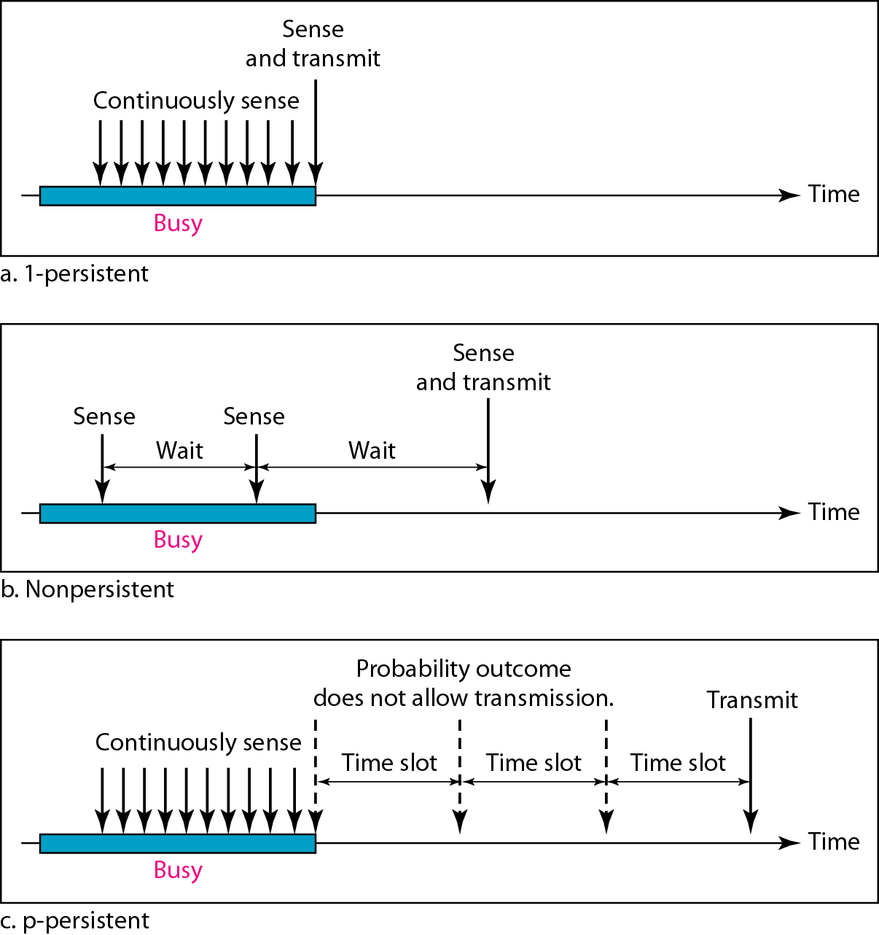
Behavior of three persistence methods
Figure 10 Behavior of three persistence methods

Slide 24
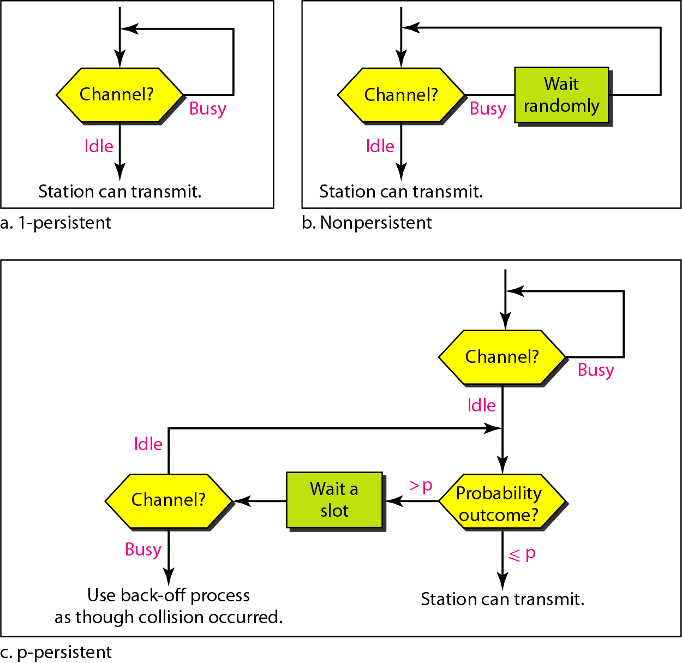
Flow diagram for three persistence methods
Figure 11 Flow diagram for three persistence methods

Slide 25
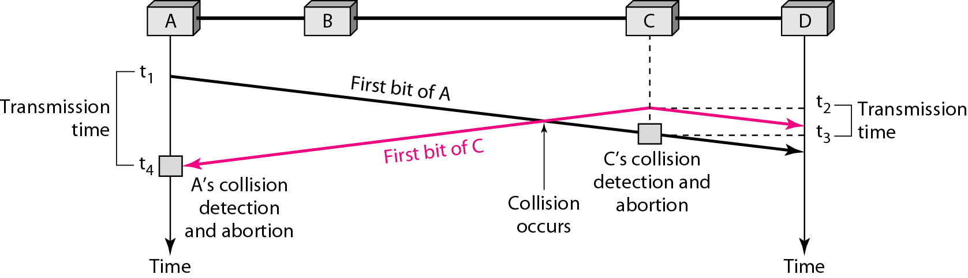
Collision of the first bit in CSMA/CD
Figure 12 Collision of the first bit in CSMA/CD

Slide 26
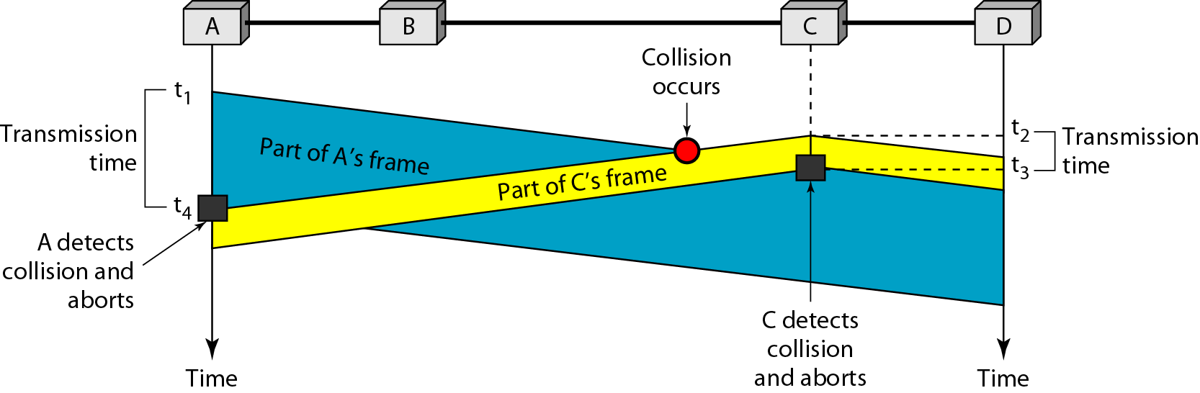
Collision and abortion in CSMA/CD
Figure 13 Collision and abortion in CSMA/CD

Slide 27
Example 5
A network using CSMA/CD has a bandwidth of 10 Mbps. If the maximum propagation time (including the delays in the devices and ignoring the time needed to send a jamming signal, as we see later) is 25.6 μs, what is the minimum size of the frame?
Solution
The frame transmission time is T_{fr} = 2 × T_{p} = 51.2 μs. This means, in the worst case, a station needs to transmit for a period of 51.2 μs to detect the collision. The minimum size of the frame is 10 Mbps × 51.2 μs = 512 bits or 64 bytes. This is actually the minimum size of the frame for Standard Ethernet.

Slide 28
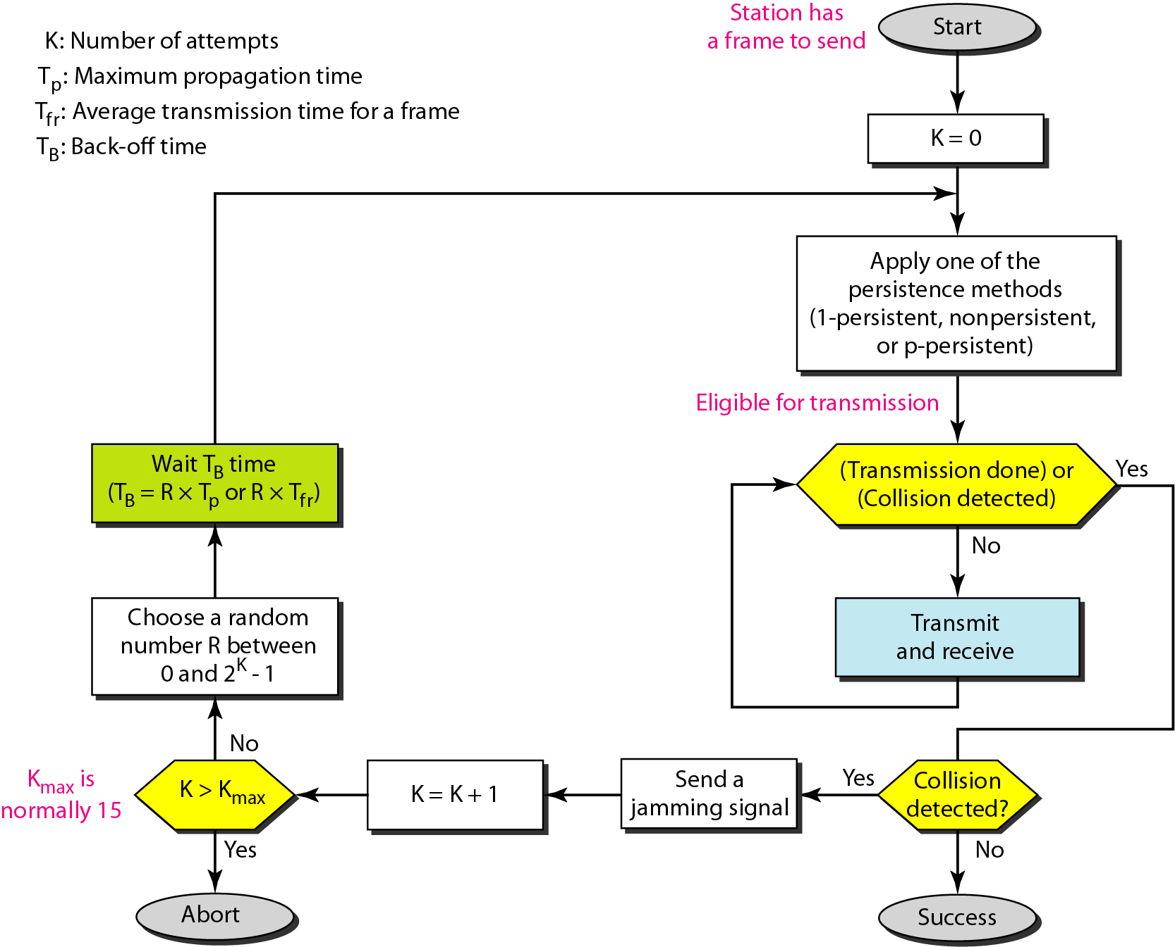
Flow diagram for the CSMA/CD
Figure 14 Flow diagram for the CSMA/CD

Slide 29
Flow diagram for the CSMA/CD
Figure 15 Flow diagram for the CSMA/CD

Slide 30
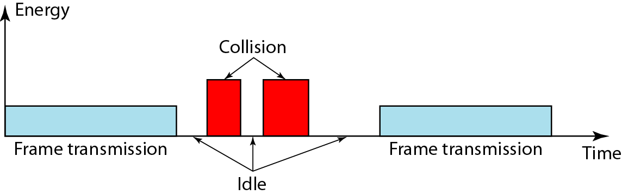
Energy level during transmission, idleness, or collision
Figure 16 Energy level during transmission, idleness, or collision

Slide 31
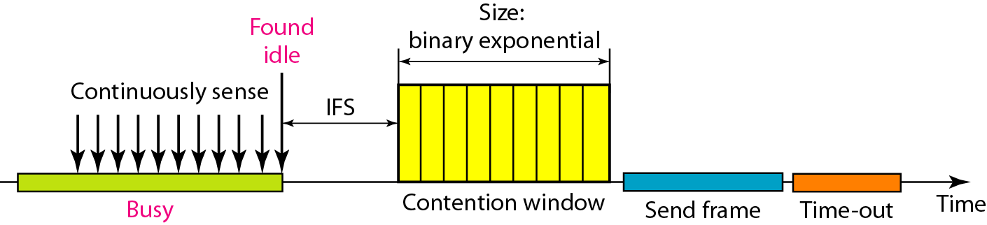
Timing in CSMA/CA
Figure 17 Timing in CSMA/CA

Slide 32
IFS in CSMA/CA
In CSMA/CA, the IFS can also be used to define the priority of a station or a frame.

Slide 33
Congestion in CSMA/CA
In CSMA/CA, if the station finds the channel busy, it does not restart the timer of the contention window;
it stops the timer and restarts it when the channel becomes idle.

Slide 34
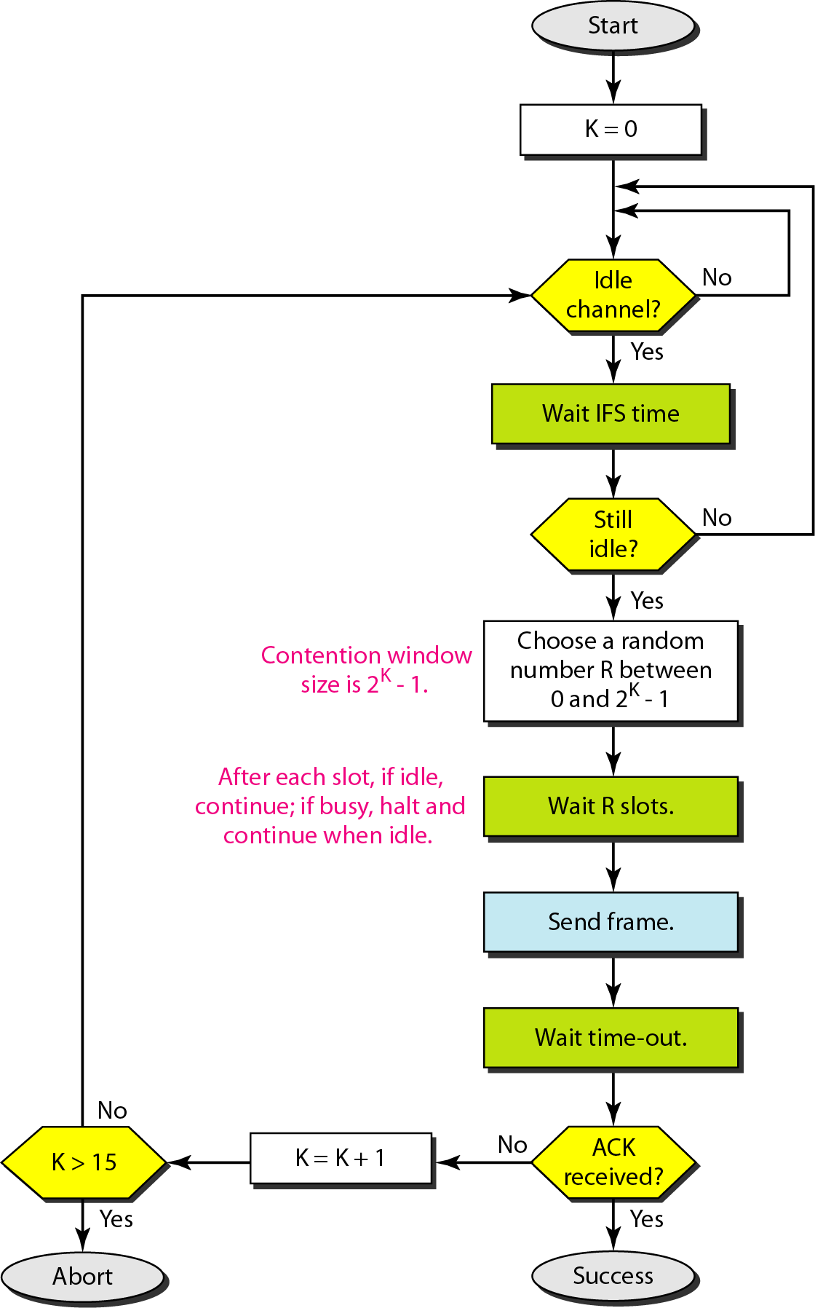
Flow diagram for CSMA/CA
Figure 18 Flow diagram for CSMA/CA

Slide 35
Practice Questions
1. Which of the following are the types of basic protocols that are present in multiple access control in data link layer?
a) Random, controlled, channelization
b) Controlled, channelization
c) Random, channelization
d) Random, controlled, contributed
2. Why station need to wait random amount of time for re-transmission of the frame after collision in pure aloha?
a) To prevent other stations
b) To avoid more collisions
c) To detect other collisions
d) To get acknowledgment from the receiver
3. Which of the following type of multiple access protocols uses a scheme called “Authorization from other stations”?
a) Random access protocol
b) Controlled access protocol
c) Channelization
d) Persistent method

Slide 36
References
https://www.netacad.com/portal/learning
https://pinoybix.org/2017/07/mcq-in-network-layer-internet-protocol-forouzan.html
https://edurev.in/course/quiz/attempt/-1_Test-Ipv4--IP-Packet/0decdb37-7206-4824-afdd-d47013a5c4cd

